Slide 1
File Systems
Inf-2201, University of Tromsø, Spring 2014
Lars Ailo Bongo (larsab@cs.uit.no)
Based on slides from Kai Li, Princeton University

Slide 2
Overview
Part 1 (today)
File system abstractions and operations
Protection
File system structure
Disk allocation and i-nodes
Directory and link implementations
Physical layout for performance
Part II (Tuesday)
Performance and reliability
File buffer cache
Disk failure and file recovery tools
Consistent updates
Transactions and logging

Slide 3
Why Files?
Can’t we just use main memory?
Can’t we use a mechanism like swapping to disk?
Need to store large amount of information
Need the information to survive process termination
Need the information to be shareable by processes

Slide 4
Recall Some High-level Abstractions
Processes are an abstraction for processors
Virtual memory is an abstraction for memory
File systems are an abstraction for disk (disk blocks)

Slide 5
File System Layers and Abstractions
Disk management manages physical disks
Sometimes part of volume manager
Drivers, scheduling, etc
Volume manager maps logical volume to physical disks
Provide logical unit
RAID and reconstruction
Local file system implements a file system on blocks in volumes
Local disks or network of disks
Network file system maps a network file system protocol to local file systems
NFS, CIFS, DAFS, GFS, HDFS, etc
Network File System
Local File System
Volume Manager
Disk Management

Slide 6
Volume Manager
What and why?
Group multiple disk partitions into a logical disk volume
No need to deal with physical disk, sector numbers
To read a block: read( vol#, block#, buf, n );
Volume can include RAID, tolerating disk failures
No need to know about parity disk in RAID-5, for example
No need to know about reconstruction
Volume can provide error detections at disk block level
Some products use a checksum block for 8 blocks of data
Volume can grow or shrink without affecting existing data
Volume can have remote volumes for disaster recovery
Remote mirrors can be split or merged for backups
How to implement?
OS kernel: Veritas (for SUN and NT), Linux
Disk subsystem: EMC, Hitachi, IBM

Slide 7
Block Storage vs. Files
Disk abstraction
Block oriented
Block numbers
No protection among users of the system
Data might be corrupted if machine crashes
File abstraction
Byte oriented
Named files
Users protected from each other
Robust to machine failures

Slide 8
File Structure Alternatives
Byte sequence
Read or write a number of bytes
Unstructured or linear
Unix, Windows
Record sequence
Fixed or variable length
Read or write a number of records
Not used: punch card days
Tree
Records with keys
Read, insert, delete a record (typically using B-tree, sorted on key)
Used in mainframes for commercial data processing
Other possible structures?
…
…
…
…

Slide 9
File Types
ASCII
Binary data
Record
Tree
An Unix executable file
header: magic number, sizes, entry point, flags
text
data
relocation bits
symbol table
Devices
Everything else in the system

Slide 10
File Operations
Operations for “sequence of bytes” files
Create: create a mapping from a name to bytes
Delete: delete the mapping
Open: authentication, bring key attributes, disk info into RAM
Close: free up table space, force last block write
Seek: jump to a particular location in a file
Read: read some bytes from a file
Write: write some bytes to a file
Get attributes, Set attributes
A few more on directories: talk about this later
Implementation goal
Operations should have as few disk accesses as possible and have minimal space overhead

Slide 11
Access Patterns
Sequential (the common pattern)
File data processed sequentially
Examples
Editor writes out a new file
Compiler reads a file
Random access
Address a block in file directly without passing through predecessors
Examples:
Data set for demand paging
Read a message in an inbox file
Databases
Keyed access
Search for a record with particular values
Usually not provided by today’s file systems
Examples
Database search and indexing

Slide 12
VM Page Table vs. File System Metadata
Page table
Manage the mappings of an address space
Map virtual page # to physical page #
Check access permission and illegal addressing
TLB does all in one cycle
File metadata
Manage the mappings of files
Map byte offset to disk block address
Check access permission and illegal addressing
All implement in software and may cause disk accesses

Slide 13
File System vs. Virtual Memory
Similarity
Location transparency
Oblivious to size
Protection
File system is easier than VM
CPU time to do file system mappings is not a big deal
Files are dense and mostly sequential
Page tables deal with sparse address spaces and random accesses
File system is harder than VM
Each layer of translation causes potential disk accesses
Memory space for caching is never enough
Range very extreme: many < 10k, some > GB
Implementation must be very reliable

Slide 14
Protection Policy vs. Mechanism
Policy is about what and mechanism is about how
A protection system is the mechanism to enforce a security policy
Roughly the same set of choices, no matter what policy
A security policy delineates what acceptable behavior and unacceptable behavior
Example security policies:
Each user can only allocate 40GB of disk
No one but root can write to the password file
You cannot read my mail

Slide 15
Protection Mechanisms
Authentication
Make sure system knows whom it is talking to
Unix: password
Banks: account # + last transactions
Bars: driver’s license
Authorization
Determine if x is allowed to do y
Need a simple database
Access enforcement
Enforce authorization decision
Must make sure there are no loopholes
This is difficult

Slide 16
Authentication
Usually done with passwords
This is usually a relatively weak form of authentication, since it’s something that people have to remember
Empirically is typically based on girlfriend/boyfriend/partner name
Passwords should not be stored in a directly-readable form
Use some sort of one-way-transformation (a “secure hash”) and store that
If you look in /etc/passwords will see a bunch of gibberish associated with each name. That is the password
Problem: to prevent guessing (“dictionary attacks”) passwords should be long and obscure
Unfortunately easily forgotten and usually written down
What are the alternatives?

Slide 17
Protection Domain
A set of (objects, rights) pairs
Domain may correspond to single user, or more general
Process runs in a domain at a given instant in time
Once identity known, what is Bob allowed to do?
More generally: must be able to determine what each “principal” is allowed to do with what
Can be represented as an “protection matrix” with one row per domain, one column per resource
What are the pros and cons of this approach?
 | File A | Printer B | File C
Domain 1 | R | W | RW
Domain 2 | RW | W | …
Domain 3 | R | … | RW

Slide 18
Access Control Lists (ACLs)
By column: For each object, indicate which users are allowed to perform which operations
In most general form, each object has a list of <user,privileged> pairs
Access control lists are simple, and are used in almost all file systems
Owner, group, world
Implementation
Stores ACLs in each file
Use login authentication to identify
Kernel implements ACLs
What are the issues?
Notes:
Granularity
Checking is not efficient: Need to enumerate all users
If checks happen at Open, then changing access control can happen only at future open ops.

Slide 19
Capabilities
By rows: For each user, indicate which files may be accessed and in what ways
Store a lists of <object, privilege> pairs which each user.
Called a Capability List
Capabilities frequently do both naming and protection
Can only “see” an object if you have a capability for it.
Default is no access
Implementation
Capability lists
Architecture support
Stored in the kernel
Stored in the user space but in encrypted format
Checking is easy: no enumeration
Issues with capabilities?
Notes:
Capabilities do not allow selective revocation of rights
Removing an object needs to remove it from capability lists

Slide 20
Access Enforcement
Use a trusted party to
Enforce access controls
Protect authorization information
Kernel is the trusted party
This part of the system can do anything it wants
If it has a bug, the entire system can be destroyed
Want it to be as small & simple as possible
Security is only as strong as the weakest link in the protection system

Slide 21
Some Easy Attacks
Abuse of valid privilege
On Unix, super-user can do anything. Read your mail, send mail in your name, etc.
If you delete the code for your COS318 project, your partner is not happy
Spoiler/Denial of service (DoS)
Use up all resources and make system crash
Run shell script to: “while(1) { mkdir foo; cd foo; }”
Run C program: “while(1) { fork(); malloc(1000)[40] = 1; }”
Run a program with RSS > DRAM + Swap space
Listener
Passively watch network traffic. Will see anyone’s password as they type it into telnet. Or just watch for file traffic: may be transmitted in plaintext.

Slide 22
No Perfect Protection System
Protection can only increase the effort needed to do something bad
It cannot prevent bad things from happening
Even assuming a technically perfect system, there are always ways to defeat
burglary, bribery, blackmail, bludgeoning, etc.
Every system has holes
It just depends on what they look like

Slide 23
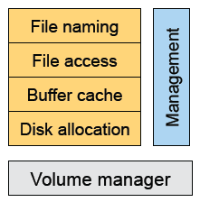
File System Components
Naming
File and directory naming
Local and remote operations
File access
Implement read/write and other functionalities
Buffer cache
Reduce client/server disk I/Os
Disk allocation
File data layout
Mapping files to disk blocks
Management
Tools for system administrators to manage file systems

Slide 24
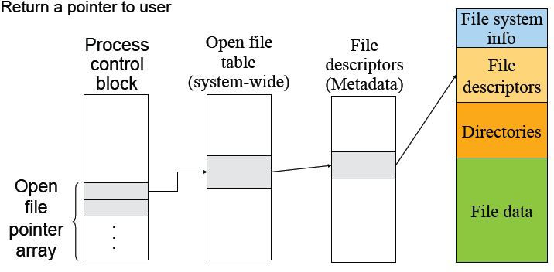
Steps to Open A File
File name lookup and authenticate
Copy the file descriptors into the in-memory data structure, if it is not in yet
Create an entry in the open file table (system wide) if there isn’t one
Create an entry in PCB
Link up the data structures
Return a pointer to user

Slide 25
File Read and Write
Read 10 bytes from a file starting at byte 2?
seek byte 2
fetch the block
read 10 bytes
Write 10 bytes to a file starting at byte 2?
seek byte 2
fetch the block
write 10 bytes in memory
write out the block

Slide 26

Disk Layout
Boot block
Code to bootstrap the operating system
Super-block defines a file system
Size of the file system
Size of the file descriptor area
Free list pointer, or pointer to bitmap
Location of the file descriptor of the root directory
Other meta-data such as permission and various times
Kernel keeps in main memory, and is replicated on disk too
File descriptors
Each describes a file
File data blocks
Data for the files, the largest portion on disk

Slide 27
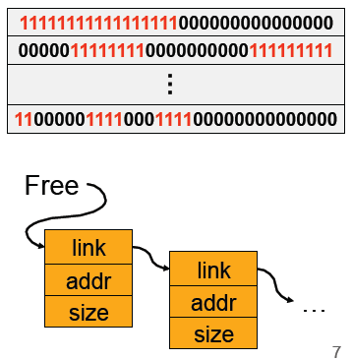
Data Structures for Disk Allocation
The goal is to manage the allocation of a volume
A file header for each file
Disk blocks associated with each file
A data structure to represent free space on disk
Bit map that uses 1 bit per block (sector)
Linked list that chains free blocks together
…

Slide 28

Contiguous Allocation
Request in advance for the size of the file
Search bit map or linked list to locate a space
File header
First block in file
Number of blocks
Pros
Fast sequential access
Easy random access
Cons
External fragmentation (what if file C needs 3 blocks)
Hard to grow files: may have to move (large) files on disk
May need compaction

Slide 29
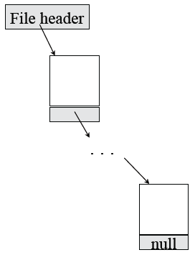
Linked Files (Alto)
File header points to 1st block on disk
A block points to the next
Pros
Can grow files dynamically
Free list is similar to a file
No external fragmentation or need to move files
Cons
Random access: horrible
Even sequential access needs one seek per block
Unreliable: losing a block means losing the rest

Slide 30
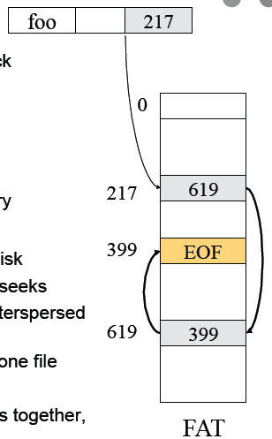
File Allocation Table (FAT)
Approach
Table of “next pointers”, indexed by block
Instead of pointer stored with block
Directory entry points to 1st block of file
Pros
No need to traverse list to find a block
Cache FAT table and traverse in memory
Cons
FAT table takes lots of space for large disk
Hard to fit in memory; so may need seeks
Pointers for all files on whole disk are interspersed in FAT table
Need full table in memory, even for one file
Solution: indexed files
Keep block lists for different files together, and in different parts of disk

Slide 31
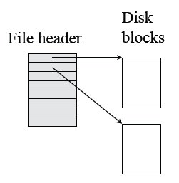
Single-Level Indexed Files
A user declares max size
A file header holds an array of pointers to point to disk blocks
Pros
Can grow up to a limit
Random access is fast
Cons
Clumsy to grow beyond the limit
Still lots of seeks

Slide 32
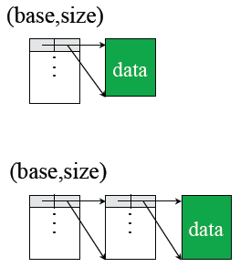
DEMOS (Cray-1)
Idea
Using contiguous allocation
Allow non-contiguous
Approach
10 (base,size) pointers
Indirect for big files

Slide 33
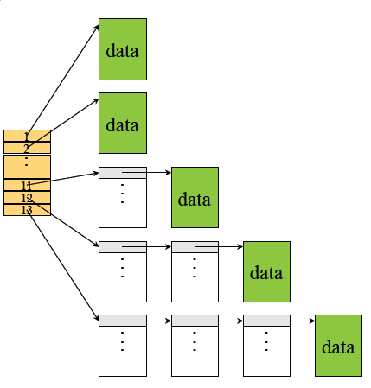
Multi-Level Indexed Files (Unix)
13 Pointers in a header
0…10: direct pointers
11: 1-level indirect
12: 2-level indirect
13: 3-level indirect
Pros & Cons
In favor of small files
Can grow
Limit is 16G and lots of seek

Slide 34
What’s in Original Unix i-node?
Mode: file type, protection bits, setuid, setgid bits
Link count: number of directory entries pointing to this
Uid: uid of the file owner
Gid: gid of the file owner
File size
Times (access, modify, change)
No filename (why?)
10 pointers to data blocks
Single indirect pointer
Double indirect pointer
Triple indirect pointer

Slide 35
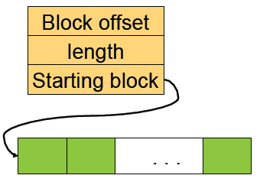
Extents
Instead of using a fixed size block, use a number of blocks
XFS uses 8Kbyte block
Max extent size is 2M blocks
Index nodes need to have
Block offset
Length
Starting block
Is this approach better than the Unix i-node approach?

Slide 36
Naming
Text name
Need to map it to index
Index (i-node number)
Ask users to specify i-node number
Icon
Need to map it to index or map it to text then to index

Slide 37
Directory Organization Examples
Flat (CP/M)
All files are in one directory
Hierarchical (Unix)
/home/foo/bar
Directory is stored in a file containing (name, i-node) pairs
The name can be either a file or a directory
Hierarchical (Windows)
C:\Users\foo\bar
Use the extension to indicate whether the entry is a directory

Slide 38
Mapping File Names to i-nodes
Create/delete
Create/delete a directory
Open/close
Open/close a directory for read and write
Should this be the same or different from file open/close?
Link/unlink
Link/unlink a file
Rename
Rename the directory

Slide 39
Linear List
Method
<FileName, i-node> pairs are linearly stored in a file
Create a file
Append <FileName, i-node>
Delete a file
Search for FileName
Remove its pair from the directory
Compact by moving the rest
Pros
Space efficient
Cons
Linear search
Need to deal with fragmentation
/home/larsab/foo/bar/… veryLongFileName
<foo,1234> <bar,1235> … <veryLongFileName,
4567>

Slide 40
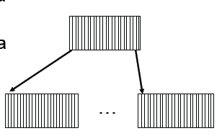
Tree Data Structure
Method
Store <fileName, i-node> a tree data structure such as B-tree
Create/delete/search in the tree data structure
Pros
Good for a large number of files
Cons
Inefficient for a small number of files
More space
Complex

Slide 41
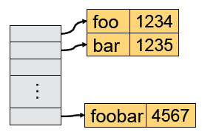
Hashing
Method
Use a hash table to map FileName to i-node
Space for name and metadata is variable sized
Create/delete will trigger space allocation and free
Pros
Fast searching and relatively simple
Cons
Not as efficient as trees for very large directory (wasting space for the hash table)

Slide 42
Disk I/Os to Read/Write A File
Disk I/Os to access a byte of /home/foo/bar
Read the i-node and first data block of “/”
Read the i-node and first data block of “home”
Read the i-node and first data block of “foo”
Read the i-node and first data block of “bar”
Disk I/Os to write a file
Read the i-node of the directory and the directory file.
Read or create the i-node of the file
Read or create the file itself
Write back the directory and the file
Too many I/Os to traverse the directory
Solution is to use Current Working Directory

Slide 43
Links
Symbolic (soft) links
A symbolic link is just the name of the file
Original owner still owns the file, really deleted on rm by owner
Use a new i-node for the symbolic link ln –s source target
Hard links
A link to a file with the same i-node ln source target
Delete may or may not remove the target depending on whether it is the last one (link reference count)
Why symbolic or hard links?
How would you implement them?

Slide 44
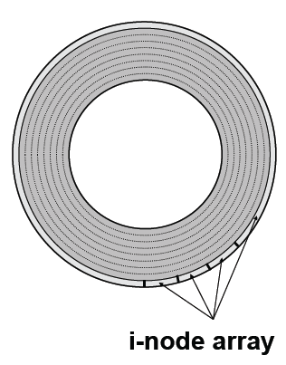
Original Unix File System
Simple disk layout
Block size is sector size (512 bytes)
i-nodes are on outermost cylinders
Data blocks are on inner cylinders
Use linked list for free blocks
Issues
Index is large
Fixed max number of files
i-nodes far from data blocks
i-nodes for directory not close together
Consecutive blocks can be anywhere
Poor bandwidth (20Kbytes/sec even for sequential access!)

Slide 45
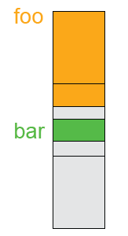
BSD FFS (Fast File System)
Use a larger block size: 4KB or 8KB
Allow large blocks to be chopped into fragments
Used for little files and pieces at the ends of files
Use bitmap instead of a free list
Try to allocate contiguously
10% reserved disk space

Slide 46
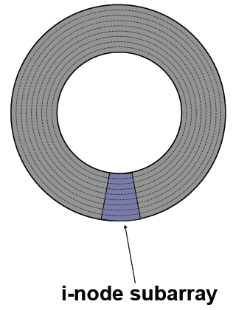
FFS Disk Layout
i-nodes are grouped together
A portion of the i-node array on each cylinder
Do you ever read i-nodes without reading any file blocks?
Overcome rotational delays
Skip sector positioning to avoid the context switch delay
Read ahead: read next block right after the first

Slide 47
What Has FFS Achieved?
Performance improvements
20-40% of disk bandwidth for large files (10-20x original)
Better small file performance (why?)
We can still do a lot better
Extent based instead of block based
Use a pointer and size for all contiguous blocks (XFS, Veritas file system, etc)
Synchronous metadata writes hurt small file performance
Asynchronous writes with certain ordering (“soft updates”)
Logging (talk about this later)
Play with semantics (/tmp file systems)

Slide 48
Summary - Part 1
Protection
We basically live with access control list
More protection is needed in the future
File system structure
Boot block, super block, file metadata, file data
File metadata
Consider efficiency, space and fragmentation
Directories
Consider the number of files
Links
Soft vs. hard
Physical layout
Where to put metadata and data

Slide 49
Overview
Part 1 (Tuesday)
File system abstractions and operations
Protection
File system structure
Disk allocation and i-nodes
Directory and link implementations
Physical layout for performance
Part II (today)
File system structure
Physical layout for performance
Performance and reliability
File buffer cache
Disk failure and file recovery tools
Consistent updates
Transactions and logging
Part III (April 23rd, P6 Precepts, Erlend)
Linux File System

Slide 50
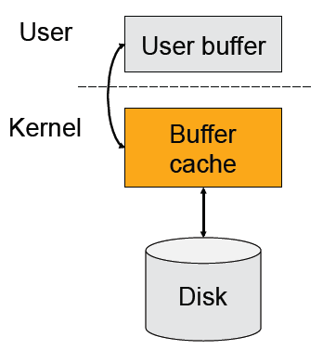

File Buffer Cache for Performance
Cache files in main memory
Check the buffer cache first
Hit will read from or write to the buffer cache
Miss will read from the disk to the buffer cache
Usual questions
What to cache?
How to size?
What to prefetch?
How and what to replace?
Which write policies?

Slide 51
What to Cache?
Things to consider
I-nodes and indirect blocks of directories
Directory files
I-nodes and indirect blocks of files
Files
What is a good strategy?
Cache i-nodes and indirect blocks if they are in use?
Cache only the i-nodes and indirect blocks of the current directory?
Cache an entire file vs. referenced blocks of files

Slide 52
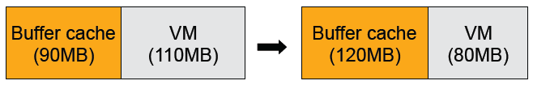
How to Size?
An important issue is how to partition memory between the buffer cache and VM cache
Early systems use fixed-size buffer cache
It does not adapt to workloads
Later systems use variable size cache
But, large files are common, how do we make adjustment?
Basically, we solve the problem using the working set idea

Slide 53
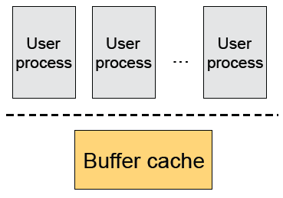
Challenges: Multiple User Processes
Kernel
All processes share the same buffer cache
Global LRU may not be fair
Solution
Working set idea again
Questions
Can each process use a different replacement strategy?
Can we move the buffer cache to the user level?
What about duplicates?

Slide 54
What to Prefetch?
Optimal
The blocks are fetched in just enough time to use them
But, too hard to do
The good news is that files also have locality
Temporal locality
Spatial locality
Common strategies
Prefetch next k blocks together (typically > 64KB)
Some discard unreferenced blocks
Cluster blocks of the same directory and i-nodes if possible (to the same cylinder group and neighborhood) to make prefetching efficient

Slide 55
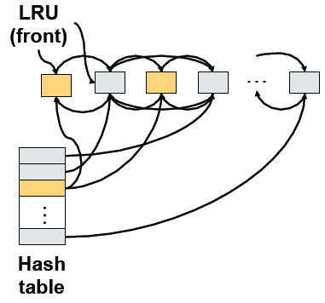
How and What to Replace?
Page replacement theory
Use past to predict future
LRU is good
Buffer cache with LRU replacement mechanism
If b is in buffer cache, move it to front and return b
Otherwise, replace the tail block, get b from disk, insert b to the front
Use double linked list with a hash table

Slide 56
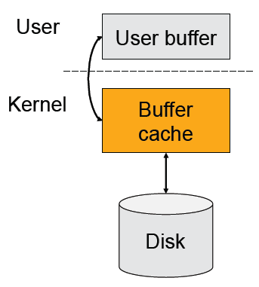
Which Write Policies?
Write through
Whenever modify cached block, write block to disk
Cache is always consistent
Simple, but cause more I/Os
Write back
When modifying a block, mark it as dirty & write to disk later
Fast writes, absorbs writes, and enables batching
So, what’s the problem?

Slide 57
Write Back Complications
Fundamental tension
On crash, all modified data in cache is lost.
The longer you postpone write backs, the faster you are but the worst the damage is on a crash
When to write back
When a block is evicted
When a file is closed
On an explicit flush
When a time interval elapses (30 seconds in Unix)
Issues
These write back options have no guarantees
A solution is consistent updates (later)

Slide 58
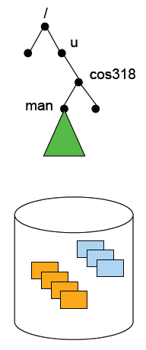
File Recovery Tools
Physical backup (dump) and recovery
Dump disk blocks by blocks to a backup system
Backup only changed blocks since the last backup as an incremental
Recovery tool built accordingly
Logical backup (dump) and recovery
Traverse the logical structure from the root
Selectively dump what you want to backup
Verify logical structures as you backup
Recovery tool selectively move files back
Consistency check (e.g. fsck)
Start from the root i-node
Traverse the whole tree and mark reachable files
Verify the logical structure
Figure out what blocks are free

Slide 59
What fsck does
Get default list of filesystems to check from /etc/fstab
Inconsistencies checked:
Blocks claimed by more than one i-node or the free map
Blocks claimed by an i-node outside range of the filesystem
Incorrect link counts
Size checks (directory size etc)
Bad i-node format
Blocks not accounted for anywhere
Directory checks:
File pointing to unallocated i-node; I-node number out of range; . or .. Not first two entries of a directory or have wrong i-node number
Super Block checks
More blocks for i-nodes than are in the filesystem; Bad free block map format; Total free block and/or free i-node count incorrect
Put orphaned files and directories in lost+found directory

Slide 60
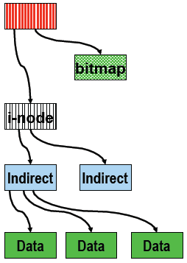
Recovery from Disk Block Failures
Boot block
Create a utility to replace the boot block
Use a flash memory to duplicate the boot block and kernel
Super block
If there is a duplicate, remake file system
Free block data structure
Search all reachable files from the root
Unreachable blocks are free
i-node blocks
How to recover?
Indirect or data blocks

Slide 61
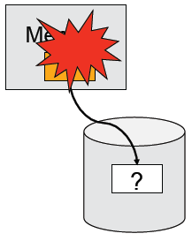
Persistency and Crashes
File system promise: Persistency
File system will hold a file until its owner explicitly deletes it
Why is this hard?
A crash will destroy memory content
Cache more ⇒ better performance
Cache more ⇒ lose more on a crash
A file operation often requires modifying multiple blocks, but the system can only atomically modify one at a time
Systems can crash anytime

Slide 62
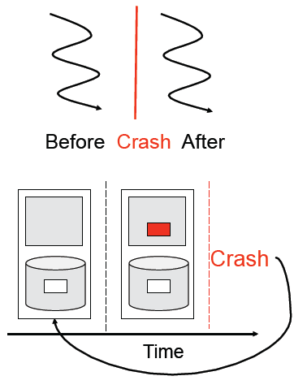
What is a Crash?
Crash is like a context switch
Think about a file system as a thread before the context switch and another after the context switch
Two threads read or write same shared state?
Crash is like time travel
Current volatile state lost; suddenly go back to old state
Example: move a file
Place it in a directory
Delete it from old
Crash happens and both directories have problems

Slide 63
Approaches
Throw everything away and start over
Done for most things (e.g., make again)
Not what you want to happen to your email
Reconstruction
Figure out where you are and make the file system consistent and go from there
Try to fix things after a crash (“fsck”)
Make updates consistent
Either new data or old data, but not garbage data
Make multiple updates appear atomic
Build arbitrary sized atomic units from smaller atomic ones
Similar to how we built critical sections

Slide 64
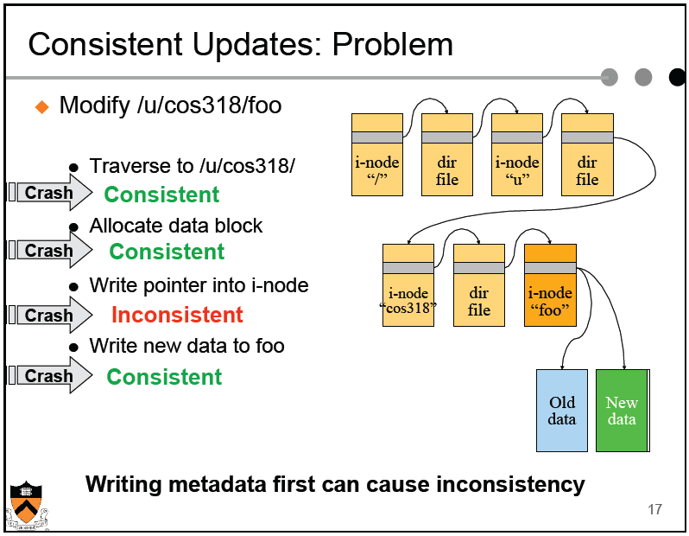

Slide 65
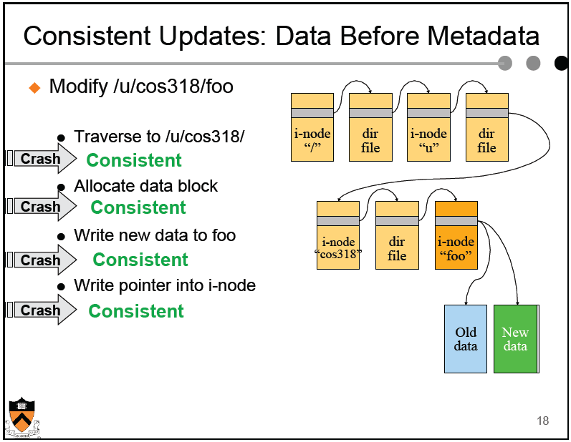

Slide 66
Consistent Updates: Bottom-Up Order
The general approach is to use a “bottom up” order
File data blocks, file i-node, directory file, directory i-node, …
What about file buffer cache?
Write back all data blocks
Update file i-node and write it to disk
Update directory file and write it to disk
Update directory i-node and write it to disk (if necessary)
Continue until no directory update exists
Does this solve the write back problem?
Updates are consistent but leave garbage blocks around
May need to run fsck to clean up once a while
Ideal approach: consistent update without leaving garbage

Slide 67
Transactions
E.g. move money from Savings to Checking in bank BEGIN_TRANSACTION Success1 = Withdraw ($300, Savings); Success2 = Deposit ($300, Checking); IF (!Success1 or !Success2) THEN ABORT_TRANSACTION ELSE END_TRANSACTION

Slide 68
Transaction Properties
Group multiple operations together so that they have “ACID” property:
Atomicity
Consistency
Isolation (Serializability)
Durability (Persistence)
Once it happens, stays happened
Question
Do critical sections have ACID property?

Slide 69
Transaction Properties
Atomicity
Either entire transaction happens, or none of it does
If transaction happens, it appears to have happened as a single atomic action (across all resources it touches)
Consistency
A transaction results in a valid transformation of the system state; i.e. the results of the transaction do not violate the rules or invariants of the system
If they held before, they hold after
E.g. total money in bank is not changed by internal transaction
Invariants need not be maintained within transaction, only before and after

Slide 70
Transaction Properties
Isolation (aka Serializability)
If two or more transactions are running concurrently, then to each of them and to all external processes, the final result looks as if all transactions ran sequentially in some (system-dependent) order.
i.e. they appear to have run serially, not concurrently
From outside the transaction, cannot see intermediate results
Durability (aka Persistence)
Once a transaction has successfully committed, its results are permanent, regardless of what failures happen after that
No later failure can undo the results or cause them to be lost

Slide 71
Transactions
Bundle many operations into a transaction
One of the first transaction systems was the Sabre American Airline reservation system, developed by IBM
Primitives
BeginTransaction
Mark the beginning of the transaction
Commit (End transaction)
When transaction is done
Rollback (Abort transaction)
Undo all the actions since “Begin transaction.”
Rules
Transactions can run concurrently
Rollback can execute anytime
Sophisticated transaction systems allow nested transactions

Slide 72
Implementation
BeginTransaction
Start using a “write-ahead” log on disk
Log all updates
Commit
Write “commit” at the end of the log
Then “write-behind” to disk by writing updates to disk
Clear the log
Rollback
Clear the log
Crash recovery
If there is no “commit” in the log, do nothing
If there is “commit,” replay the log and clear the log
Assumptions
Writing to disk is correct (recall the error detection and correction)
Disk is in a good state before we start

Slide 73
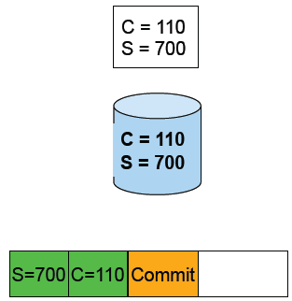
An Example: Atomic Money Transfer
Move $100 from account S to C (1 thread): BeginTransaction S = S - $100; C = C + $100; Commit
Steps:
Write new value of S to log
Write new value of C to log
Write commit
Write S to disk
Write C to disk
Clear the log
Possible crashes
After 1
After 2
After 3 before 4 and 5
Questions
Can we swap 3 with 4?
Can we swap 4 and 5?

Slide 74
Revisit The Implementation
BeginTransaction
Start using a “write-ahead” log on disk
Log all updates
Commit
Write “commit” at the end of the log
Then “write-behind” to disk by writing updates to disk
Clear the log
Rollback
Clear the log
Crash recovery
If there is no “commit” in the log, do nothing
If there is “commit,” replay the log and clear the log
Questions
What is “commit?”
What if there is a crash during the recovery?

Slide 75
Two Threads Run Transactions
Apply to the mid-term AtomicTransfer program 1: BeginTransaction 2: if ( a1->id < a2->id ) { Acquire( a1->lock ); Acquire( a2->lock ); } else { Acquire( a2->lock ); Acquire( a1->lock ); } 3: if ((a1->balance - $100 ) < 0) { Release( a2->lock ); Release( a1->lock ); goto 7; } 4: a1->balance -= $100; 5: a2->balance += $100; 6: Release( a2->lock ); Release( a1->lock ); 7: Commit
What happens if
Thread A performs 1-6; context switch
Thread B performs 1-7; crash!

Slide 76
Two-Phase Locking for Transactions
First phase
Acquire all locks
Second phase
Commit operation releases all locks (no individual release operations)
Rollback operation always undo the changes first and then release all locks

Slide 77
Use Transactions in File Systems
Make a file operation a transaction
Create a file
Move a file
Write a chunk of data
…
Would this eliminate any need to run fsck after a crash?
Make arbitrary number of file operations a transaction
Just keep logging but make sure that things are idempotent: making a very long transaction
Recovery by replaying the log and correct the file system
This is called logging file system or journaling file system
Almost all new file systems are journaling (Windows NTFS, Veritas file system, file systems on Linux)

Slide 78
Issue with Logging: Performance
For every disk write, we now have two disk writes (on different parts of the disk)?
It is not so bad because once written to the log, it is safe to do real writes later
Performance tricks
Changes made in memory and then logged to disk
Log writes are sequential (synchronous writes can be fast if on a separate disk)
Merge multiple writes to the log with one write
Use NVRAM (Non-Volatile RAM) to keep the log

Slide 79
Log Management
How big is the log? Same size as the file system?
Observation
Log what’s needed for crash recovery
Management method
Checkpoint operation: flush the buffer cache to disk
After a checkpoint, we can truncate log and start again
Log needs to be big enough to hold changes in memory
Some logging file systems log only metadata (file descriptors and directories) and not file data to keep log size down

Slide 80
What to Log?
Physical blocks (directory blocks and inode blocks)
Easy to implement but takes more space
Which block image?
Before operation: Easy to go backward during recovery
After operation: Easy to go forward during recovery.
Both: Can go either way.
Logical operations
Example: Add name “foo” to directory #41
More compact
But more work at recovery time

Slide 81
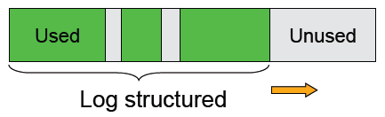
Log-structured File System (LFS)
Structure the entire file system as a log with segments
A segment has i-nodes, indirect blocks, and data blocks
All writes are sequential (no seeks)
There will be holes when deleting files
Questions
What about read performance?
How would you clean (garbage collection)?

Slide 82
Summary – Part 2
File buffer cache
True LRU is possible
Simple write back is vulnerable to crashes
Disk block failures and file system recovery tools
Individual recovery tools
Top down traversal tools
Consistent updates
Transactions and ACID properties
Logging or Journaling file systems

